Slide 1

Department of Computer Science, CUI Lahore Campus
Formal Methods in Software Engineering
By
Farooq Ahmad

Slide 2
Relation operators
Inverse, composition, identity relation

Slide 3
Topics covered
Inverse operator
Composition operation
Identity relation
Domain and range restriction

Slide 4
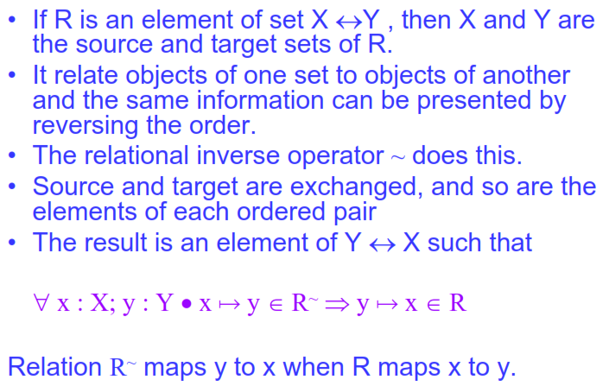
Inverse relation

Slide 5
Example 1
If teaches is the relation over Teacher x Course in University management system and one possible value of the variable teaches is
teaches = { (Dr. Hamid, Data Mining), (Dr. Ahmad, SE), (Dr. Abid, Databases) }
Then teaches⁻¹ = {(Data Mining, Dr. Hamid,), (SE, Dr. Ahmad),(Databases, Dr. Abid)}
The relation teaches⁻¹ will be taught_by OR teaches⁻¹ = taught_by
Similarly is_parent_of ⁻¹ = is_son_of

Slide 6
Example 2
Thus, if owns is a relation over Users x Computers and is currently owns = {(Wilson, D206), (Jones, AX700), (Timms, D296)},
then owns⁻¹ = {(D206, Wilson), (AX700, Jones), (D296, Timms)}.
The relation owns⁻¹ will be “owned_by”
Has_sibling is a relation over People ↔ People then has_sibling⁻¹ = has_sibling

Slide 7
Example 3
Divides is a relation over N x N then divides⁻¹ = has_divisor
Divides = {(2, 4), (3, 6)}, divides⁻¹ = {(4, 2), (6, 3)}
Successor is a relation over N x N then successor ⁻¹ = predecessor
Successor= {(2, 1), (3, 2)}, successor⁻¹ = {(1, 2), (2, 3)}

Slide 8
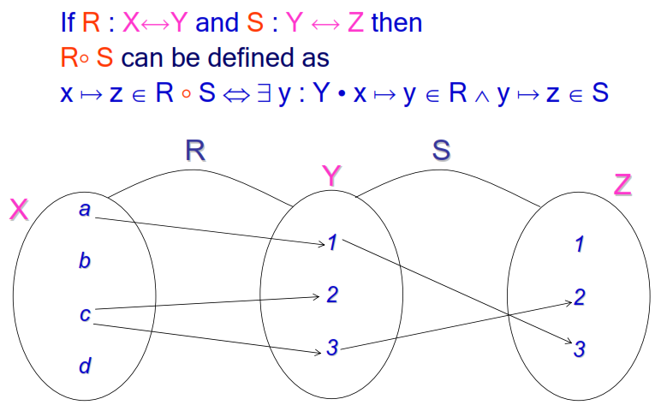
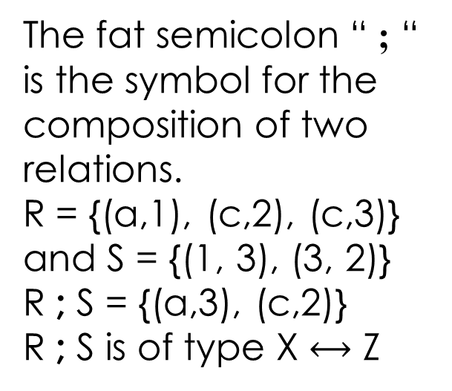
Composition operator “ ; “
If the from-set of one relation is of the same type as the to-set of another, it is possible to create a new relation from the two by composition operator.
The fat semicolon “ ; “ is the symbol for the composition of two relations.
R = {(a,1), (c,2), (c,3)} and S = {(1, 3), (3, 2)}
R ; S = {(a,3), (c,2)}
R ; S is of type X $⟷$ Z

Slide 9
Relational composition; Example 1
if the current value of the relation variable has_queues is given as:
has_queues = {(780A, q1), (780B, q2), (2060A, q3), (2060B,q4)}
And the current value of contains_trans is given as:
contains_trans = {(q1, upd1), (q1, upd3), (q3, read1), (q4, read2), (q3, read2), (q2, read4), (q2, read5), (q1, tranup)}.
has_queue ; contains_trans = {(780A, upd1), (780A, upd3), (780B, read4), (780B, read5), (2060A, read1), (2060A, read2), (2060B, read2), (780A, tranup)}.
has_queue ; contains_trans = has_trans

Slide 10
Example 2
For example;
Is_parent_of: People ↔ People
is_parent_of ; is_parent_of = is_grandparent_of
{……, (Aslam, Adnan), (Adnan, Waleed)…} ; {…, (Aslam, Adnan), (Adnan, Waleed),…..} = {......, (Aslam, Waleed), …..}
If teaches : Teacher ↔ Course and taken_by : Course ↔ Student
teaches ; taken_by = is_teacher_of
{…., (Arif, DSA),….}; {….., (DSA, Nadeem),….} = {….., (Arif, Nadeem), …..}

Slide 11
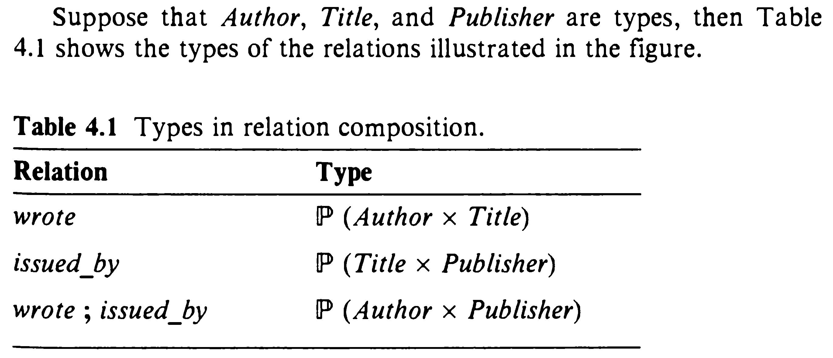
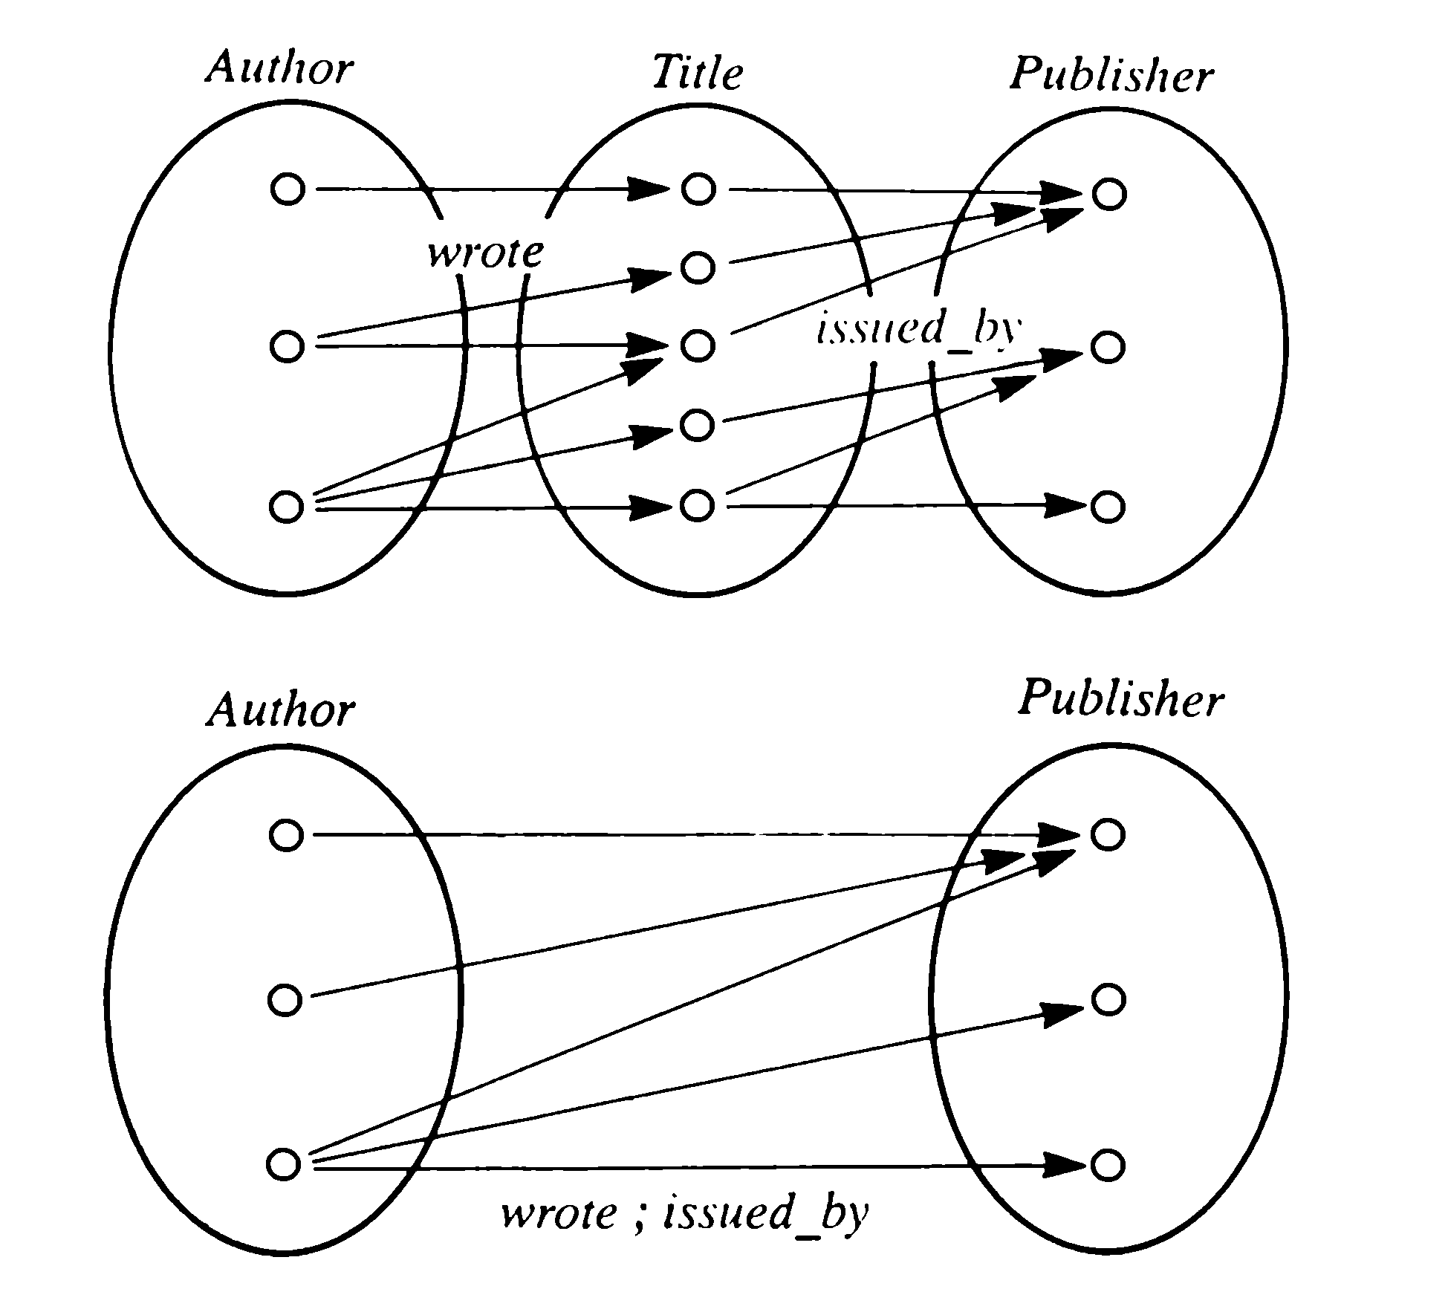
Composition of Relation variables
Wrote ; issued_by : Author ↔ Publisher
Wrote ; issued_by = get_published

Slide 12
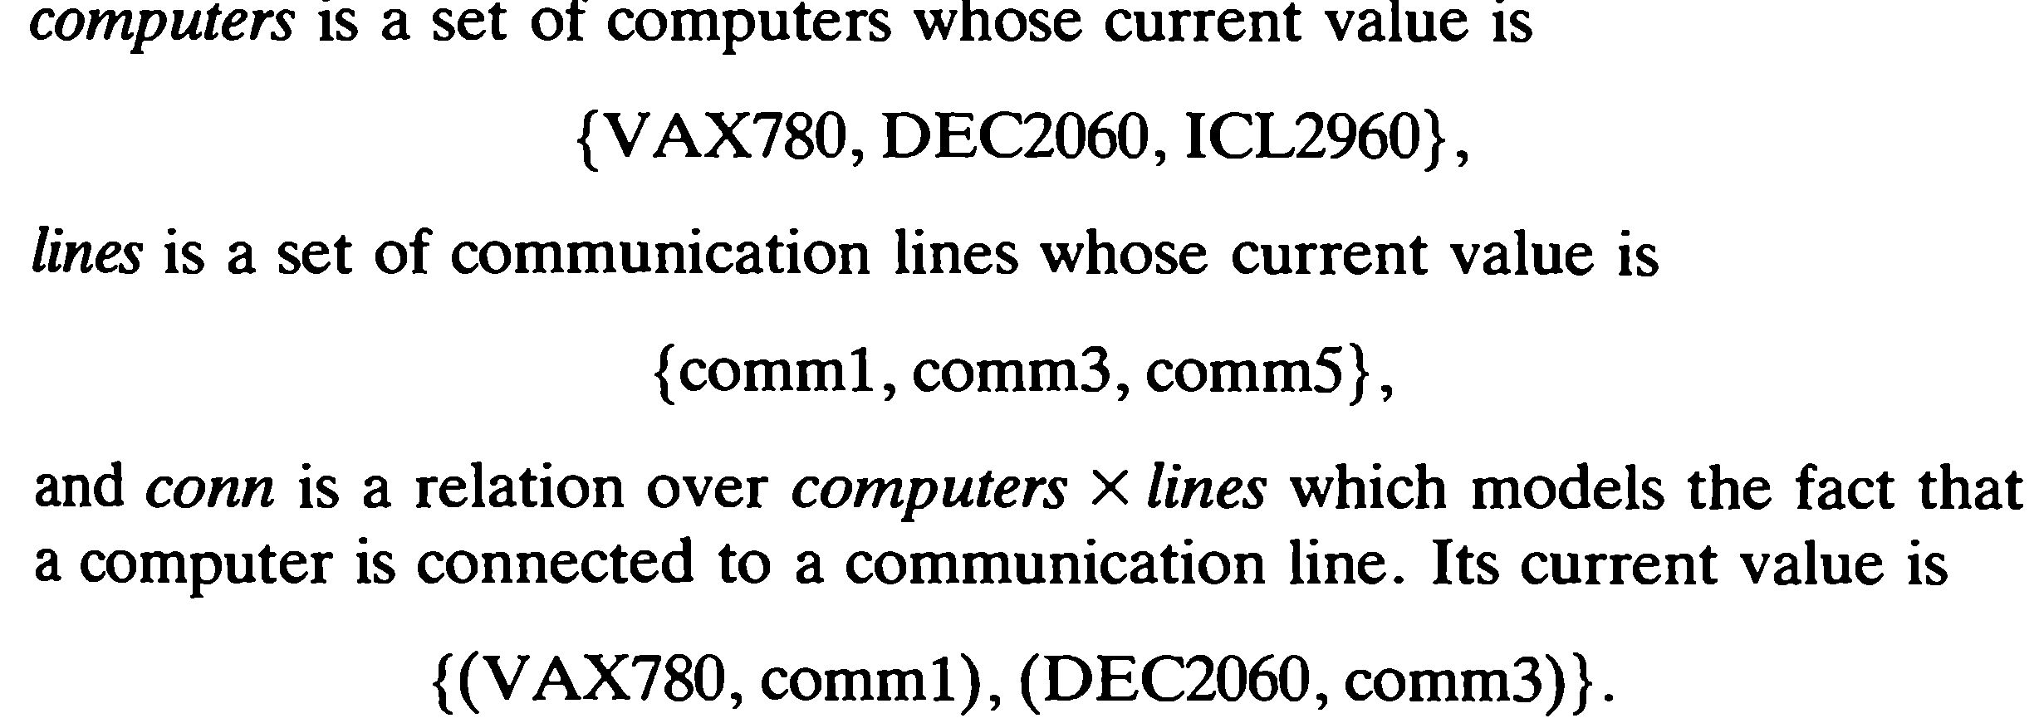
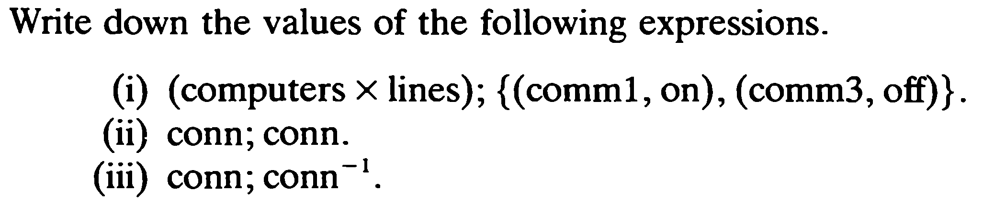
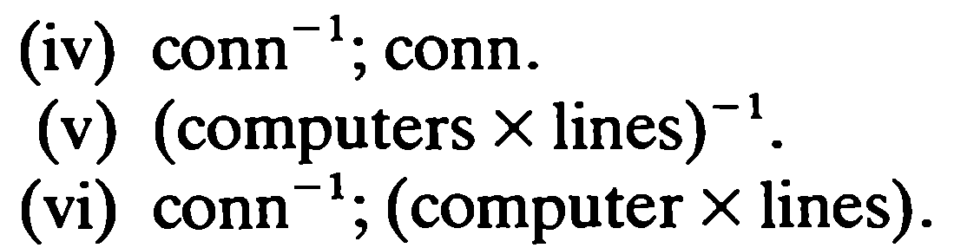
Exercise for inverse and composition operators

Slide 13
Domain and range based operators
A relation may contain a great information
often, we require only a small part.
To enable us to extract the information that we need, a number of basic functions are included in our mathematical language.
The simplest examples are the
– Restriction operator (domain restriction and rang restriction)
– Subtraction operator (domain subtraction and rang subtraction)
We often use relations to model databases. The domain restriction and range restriction operators can model database queries.

Slide 14
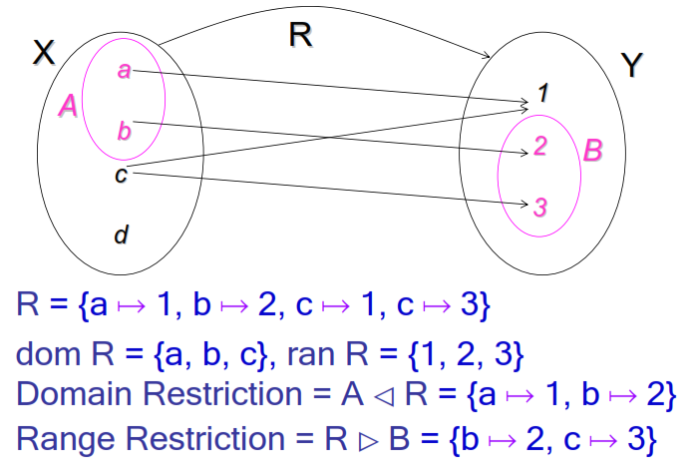
Domain and range restriction
R : X ↔ Y
A ⸦ X and B ⸦ Y

Slide 15
Domain and range restriction as database queries
R = {(a, 1), (b,2), (c, 1), (c,3)},
A = {a, b}, B = {2, 3}
R
X | Y
a | 1
b | 2
c | 1
c | 3

Slide 16
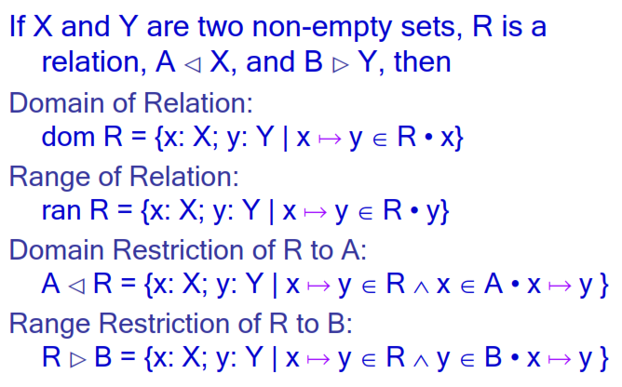
Formal definitions of domain and range restriction

Slide 17
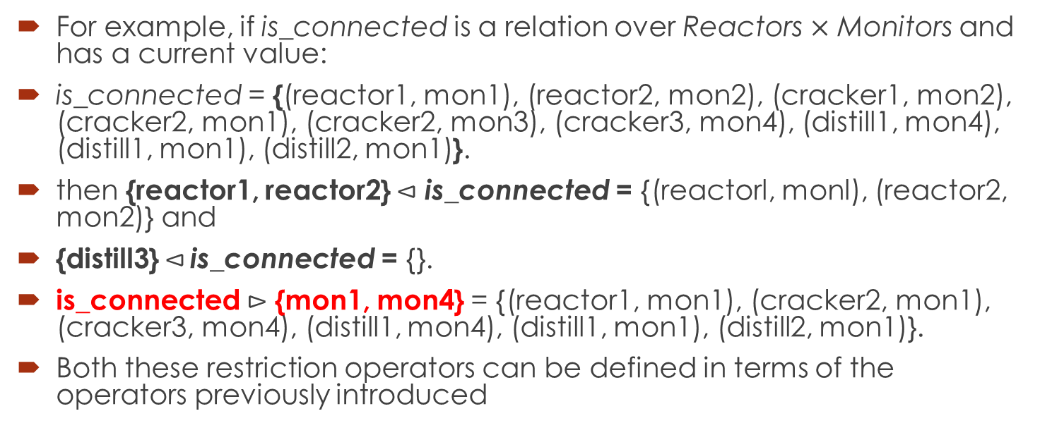
Example 1
For example, if is_connected is a relation over Reactors $×$ Monitors and has a current value:
is_connected = {(reactor1, mon1), (reactor2, mon2), (cracker1, mon2), (cracker2, mon1), (cracker2, mon3), (cracker3, mon4), (distill1, mon4), (distill1, mon1), (distill2, mon1)}.
then {reactor1, reactor2} $⊲$ is_connected = {(reactorl, monl), (reactor2, mon2)} and
{distill3}$⊲$ is_connected = {}.
is_connected $⊳$ {mon1, mon4} = {(reactor1, mon1), (cracker2, mon1), (cracker3, mon4), (distill1, mon4), (distill1, mon1), (distill2, mon1)}.
Both these restriction operators can be defined in terms of the operators previously introduced

Slide 18
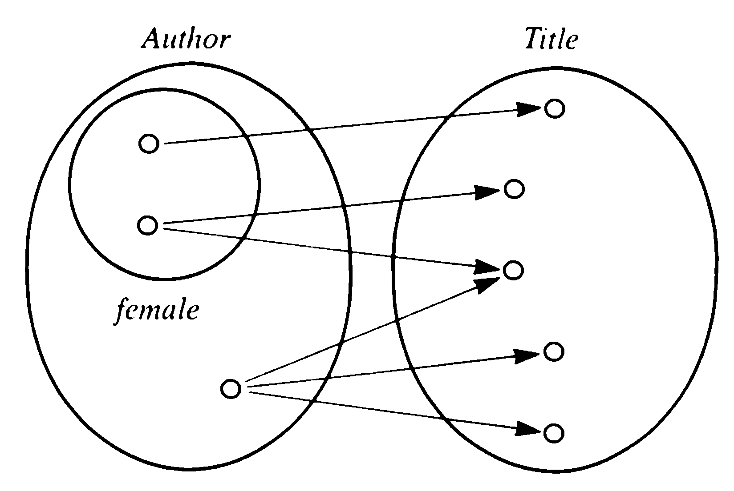
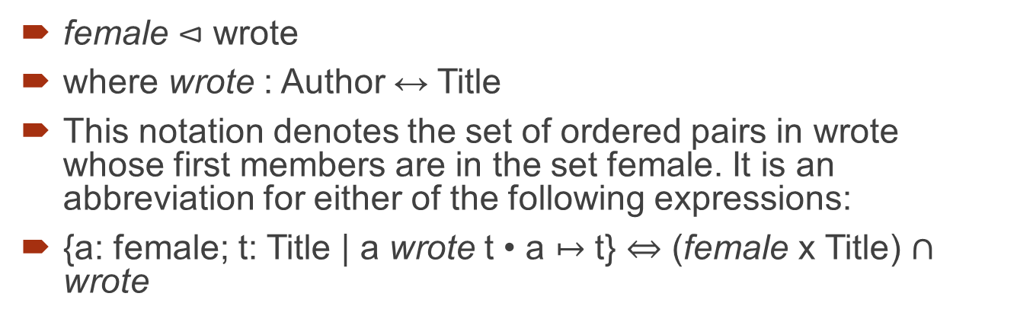
Example 2
female $⊲$ wrote
where wrote : Author ↔ Title
This notation denotes the set of ordered pairs in wrote whose first members are in the set female. It is an abbreviation for either of the following expressions:
{a: female; t: Title | a wrote t • a $↦$ t} $⇔$ (female x Title) $∩$ wrote

Slide 19
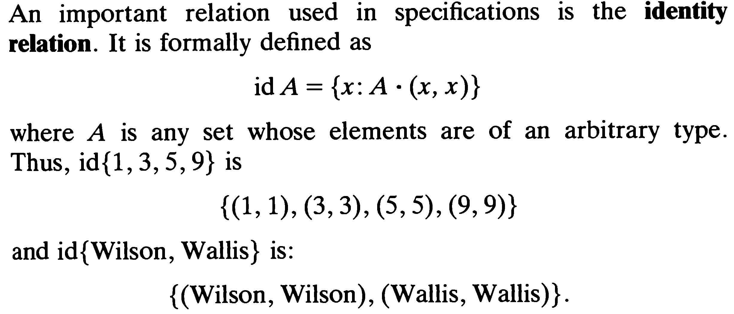
Identity relation

Slide 20
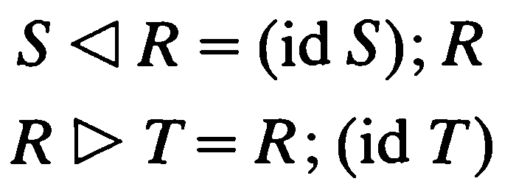
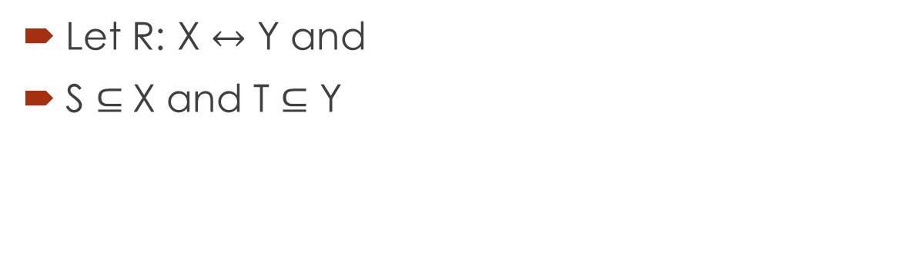
Use of the Identity relation for domain and rage restriction
Let R: X $↔$ Y and
S $⊆$X and T $⊆$ Y

Slide 21
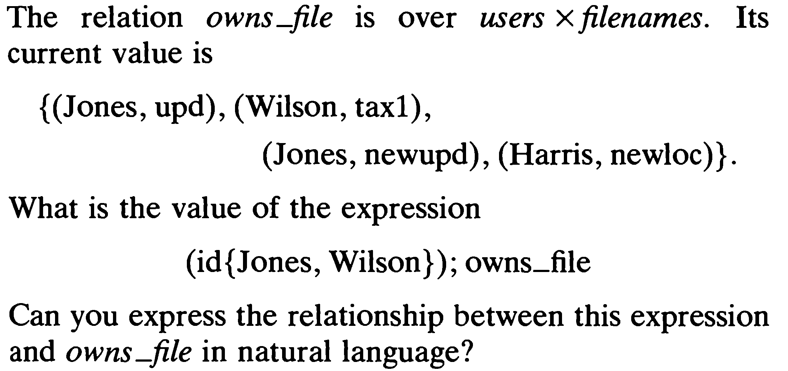
Example

Slide 22
Solution
The value of this expression is
{(Jones, Jones), (Wilson, Wilson)} ; {(Jones, upd), (Wilson, tax1), (Jones, newupd), (Harris, newloc)}
which gives {(Jones, upd), (Wilson, tax1), (Jones, newupd)}.
The effect of the operations is to form the relation between Jones or Wilson and the files which are owned by them.

Slide 23
Reference and reading material
Chapter 4: Section 4.1.7 and 4.1.8 of the book “Software development with Z”

